Slide 1
Topic Modelling: Can an ML model guess what a document is about?
Made with your Laziness in Mind

Slide 2
Problem Statement:
Given a document, we would like our model to classify it under one or more specific topic(s)
By topic, we mean a cluster of words with a common underlying “theme”
Ideally, we want these words to be related semantically with a unifying theme that is meaningful in a way humans can appreciate, although our model only groups these words and topics based on occurrence probabilities.

Slide 3
LDA considers documents as mixtures of topics, with these topics in turn being mixtures of words, each with a certain probability of pertaining to a topic.
The Key Idea of LDA
The LDA model will have to calculate the probability of each word belonging to each topic
How? …

Slide 4
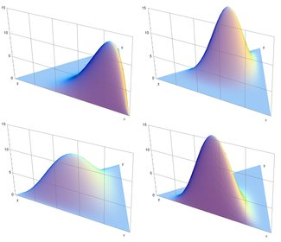
LDA, Visually

Slide 5
What’s Going on Under the Hood?
All of LDA can be condensed into 3 (friendly!) formulae:

Slide 6
1) Probability that a document d belongs to a topic t
For each document d, randomly assign each word in the document as belonging to one of k topics. Then go through each document again, and for each topic t, compute the probability that the document d “talks” about topic t.

Slide 7
2) Probability that a word w belongs to a topic t
For each topic t also, compute the significance/weight that a specific word contributes to each topic t by seeing what proportion of the topic’s words is occupied by this specific word w

Slide 8
3) Probability that a word w belongs to a topic t: Update it according to prior probabilities
We repeat the process of going through documents again and again and again… and update the probability that a word w belongs to each topic t using the prior probabilities, which get better and better at each iteration. At some point, we reach a “steady state” where the above probability no longer changes significantly: We now have our weights!

Slide 9
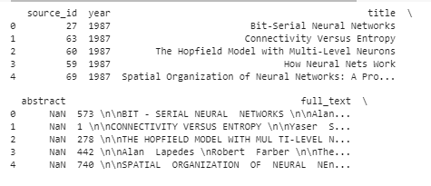
The Dataset:
The dataset includes 9,680 research papers collected between 1987 to 2019 from the Neural Information Processing Systems (NeurIPS) conferences. They are held every December and consist of talks and workshops that discuss machine learning, artificial intelligence, statistics, computational neuroscience…
The dataset after some pandas.read_csv magic

Slide 10
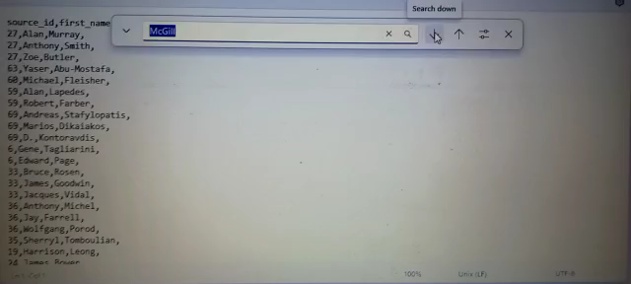
Spot Your Prof
Quite a lot of McGill professors published in NeurIPS!

Slide 11

Preprocessing
Tokenization
Stop Word Removal
“This is an example of tokenization.”
[“this”, “is”, “an”, “example”, “of”, “tokenization”]
[“example”, “tokenization”]
Lemmatization
“Studying” “Studies” and “Student” → “study”
Creating n-grams
“The patterns of neural activity in a cat’s brain are just a series of random meows, purrs, and haphazard attempts at knocking things off shelves.“
“A simple neural network consists of an input layer, a hidden layer, and an output layer.”
“neural” in sentence1 != “neural” in sentence2
Context and meaning are lost when ‘neural’ is considered independently of ‘network’

Slide 12
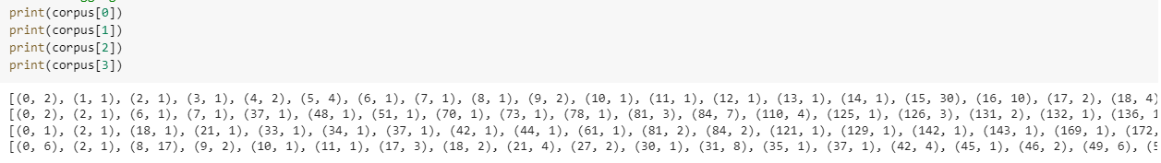
Bag-of-Words Representation
Order of words in text does not matter
Each word in the entire corpus vocabulary is assigned a unique integer id
Its frequency in the document is computed and stored like so:

Slide 13
Train-Test Split
Dataset was split into 80% training and 20% testing to give the model as robust a training set as possible for it to learn the underlying topics while setting aside some documents to help evaluate its performance on unseen data.

Slide 14
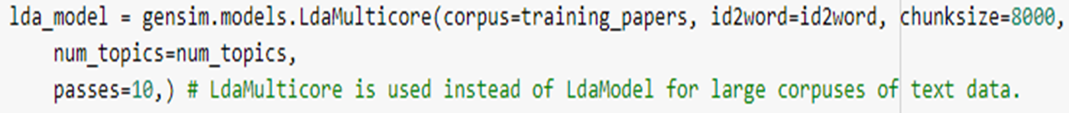
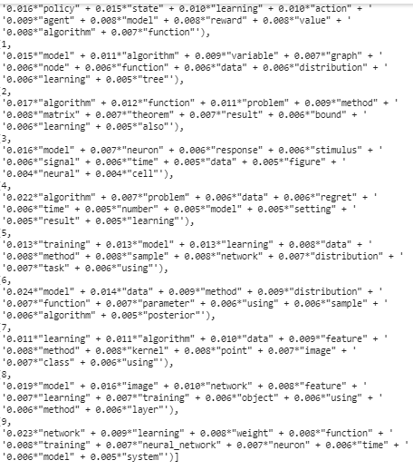
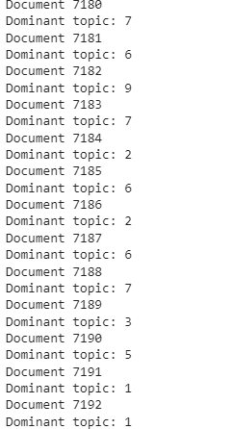
Building the LDA Model

Slide 15
Evaluating the LDA Model
Perplexity
Coherence
Intertopic Distance Maps

Slide 16
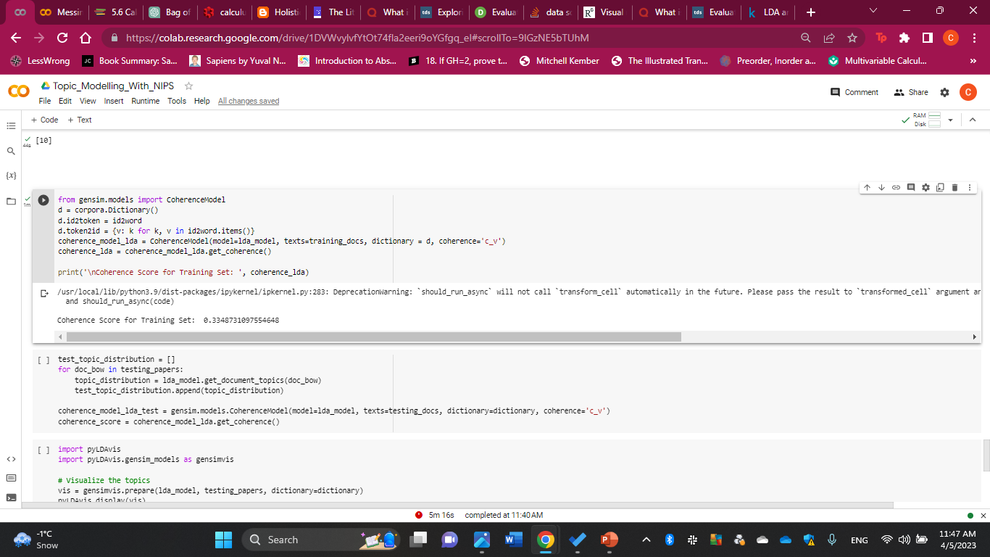
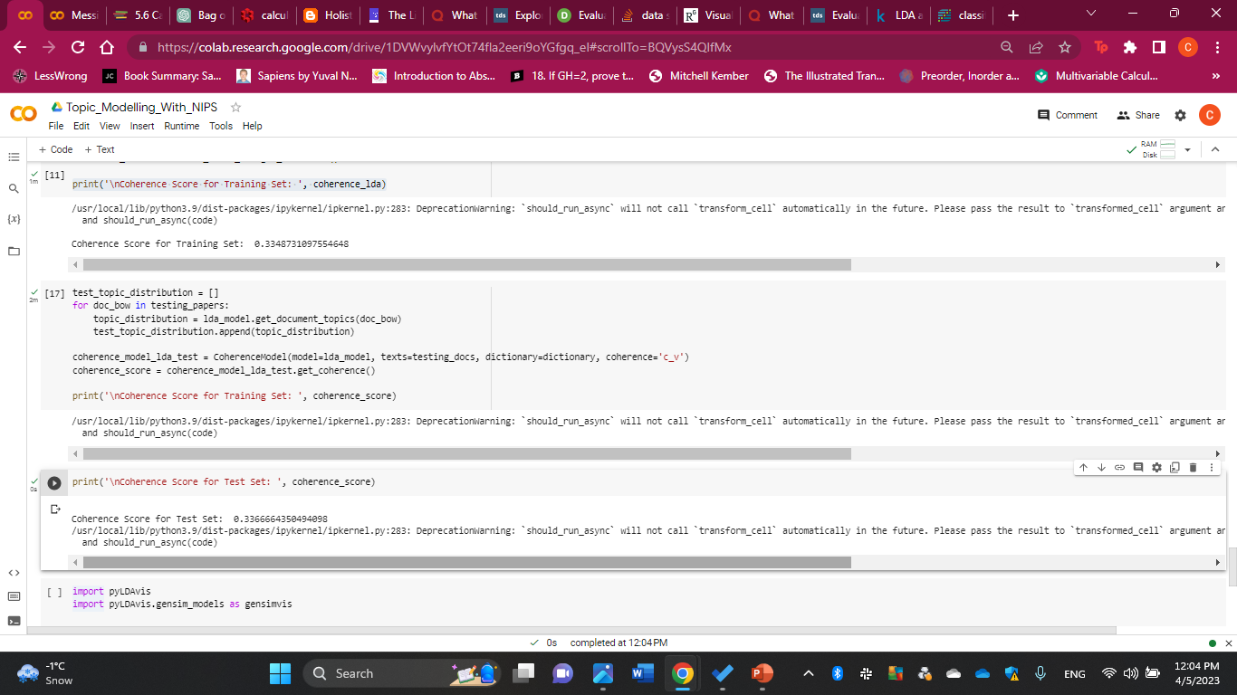
Topic Coherence
Tries to measure how “coherent” a topic is by calculating the cosine similarity of the top words in a topic
There is no “good” or “bad” coherence score; the only goal is that we maximize it
I achieved a coherence score of around 0.335 for the training set and 0.337 for the test set: The literature considers anything above 0.4 “good”

Slide 17
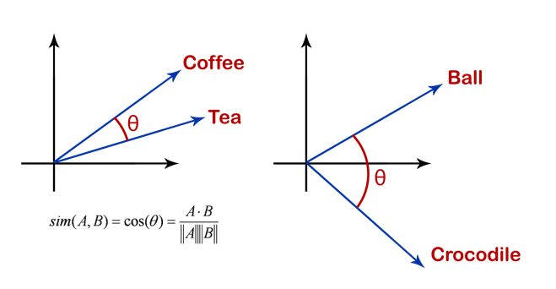
Topic Coherence

Slide 18
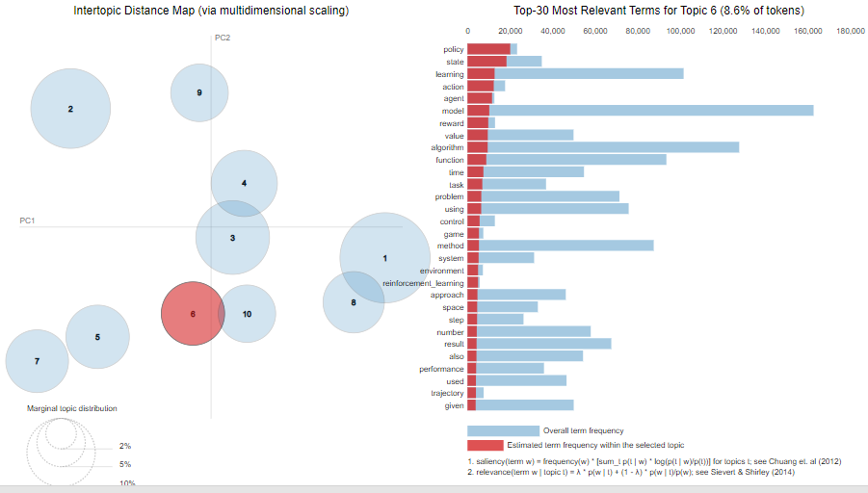
Intertopic Distance Map
Training Set

Slide 19
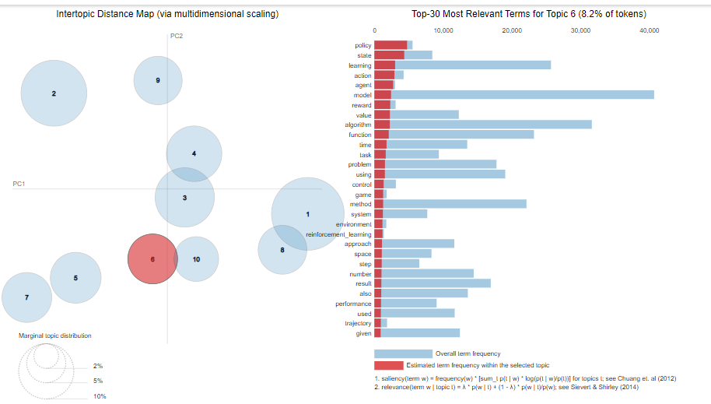
Intertopic Distance Map
Test Set

Slide 20
Intertopic Distance Map
We can detect overfitting and underfitting by examining the sizes of and distances between clusters:
Smaller clusters & Less Overlap Between Clusters → Overfitting!
Larger Clusters & More Overlap Between Clusters → Underfitting!

Slide 21
How Do the Hyperparameters of the LDA Model Affect the Results?
Number of topics k
Alpha & Beta Parameters
Number of epochs (max iterations)
Convergence Threshold

Slide 22

Thank you for making it this far without dozing off!
If you understood none of that, scan me to learn more
Clara Riachi
Department of Mathematics & Computer Science
McGill University

